Slide 1
Al-Based Tool for Preliminary Diagnosis of Dermatological Manifestations

Slide 2
INDEX
Abstract
Objective of project
Problem Statement
Scope & Motivation
Introduction
Literature survey
Existing Method
Disadvantages
Proposed method
Advantages
Project Flow
Hardware and Software Requirements
Architecture
Modules
Methodology/algorithm
UMLS
References

Slide 3
ABSTRACT
The increasing prevalence of skin diseases and the shortage of dermatologists in many regions necessitate the development of innovative solutions to assist in the preliminary diagnosis of dermatological conditions. We present an AI-based tool designed to serve as an aid for patients, general practitioners, and dermatologists. This system leverages Convolutional Neural Networks (CNN) and MobileNet architecture for the analysis of skin image datasets, providing a platform for the preliminary diagnosis of skin diseases.Upon registration, users can access different functionalities based on their role: admin/owner, patient, or doctor. The admin can train the model with a skin image dataset, view registered users, and receive feedback. Patients can log in, upload skin images, and provide additional information such as age, gender, and duration of the condition. The system then classifies the disease, provides a description, suggests remedies, and assesses disease severity. It also recommends dermatologists based on the diagnosis, allowing patients to book appointments and view their past disease history

Slide 4
Doctors can view their appointments and manage their profiles, enhancing the tool's utility for professional use. The system is designed to support both English and Telugu, broadening its accessibility. Through this AI-based diagnostic tool, we aim to bridge the gap in dermatological care by providing immediate, preliminary support, and facilitating effective patient-doctor interaction.
Keywords: Dermatological Manifestations, Supervised machine learning, CNN, MobileNet, Hybrid Algorithm.

Slide 5
STATEMENT OF THE PROBLEM
Despite advances in healthcare, there remains a significant gap in dermatological services, particularly in preliminary diagnosis. The deficit of dermatologists and the geographic limitations in accessing specialist care exacerbate the problem, leading to delayed diagnoses and treatments. This gap in service disproportionately affects rural and underserved communities, often resulting in worsened health outcomes.
The problem is twofold: firstly, there is an uneven distribution of dermatological expertise, and secondly, there is an increasing incidence of skin diseases globally. The need for an accessible, efficient, and accurate preliminary diagnostic process is critical. This study proposes to address these issues by developing an AI-based diagnostic tool that can provide immediate, preliminary assessments of dermatological conditions

Slide 6
OBJECTIVE
The overarching aim of this research is to develop an AI-based tool capable of providing preliminary diagnoses for dermatological conditions to improve the accessibility and efficiency of dermatological care. This aim is underpinned by several specific objectives:
To investigate the applicability of Convolutional Neural Networks (CNN) and MobileNet architectures in accurately classifying skin diseases from images. The study will assess the diagnostic accuracy of these AI models compared to traditional methods, aiming to match or surpass the benchmark set by human experts in recognizing and classifying various skin conditions.
To design a user-friendly interface for patients and healthcare providers. The interface should allow easy submission of skin images and relevant clinical information by patients, and facilitate the review and management of diagnostic reports by healthcare professionals.

Slide 7
SCOPE
The scope of this study encompasses the design, development, and evaluation of an AI-based tool for the preliminary diagnosis of dermatological conditions. It includes the application of CNN and MobileNet architectures for image analysis, the development of a user interface for various stakeholders (patients and healthcare providers), and the integration of multilingual support to cater to a broader demographic.The research is focused on assessing the accuracy of the AI tool in classifying skin diseases, its usability, and its impact on the accessibility and efficiency of dermatological care. The study will also explore the tool's potential to assist in the triage process within healthcare systems. Participants will involve a diverse group of users, including patients and dermatologists, to test the tool's functionality and gather feedback on its performance and user experience.
However, the study faces several limitations. Firstly, the accuracy of the AI tool is heavily dependent on the quality and diversity of the dataset used for model training. A dataset that lacks variety may not be representative of the wider population, which can limit the tool's effectiveness across different skin types and conditions.

Slide 8
INTRODCUTION
The prevalence of dermatological diseases globally is a significant health concern, with skin conditions ranking fourth among the most common causes of human illness. The complexity of skin diseases, combined with a global scarcity of dermatologists, especially in remote and underserved areas, necessitates the development of accessible diagnostic support. This disparity in healthcare access has spurred interest in leveraging artificial intelligence (AI) to bridge the diagnostic gap.
The application of AI, particularly Convolutional Neural Networks (CNN) and architectures like MobileNet, has shown promising results in image recognition tasks due to their ability to learn hierarchical representations. In dermatology, where visual inspection plays a pivotal role in diagnosis, such AI models can be trained to recognize and classify skin conditions from images with a level of precision that approaches that of trained professionals. This potential makes AI a valuable ally in preliminary skin disease diagnosis.

Slide 9
LITERATURE SURVEY
S.NO | YEAR | AUTHORS | TITLE | OUT COMES
1 | 2018, IEEE | Khalid M. Hosny, Mohamed A. Kassem, and Mohamed M. Foaud | Skin Cancer Classification using Deep Learning and Transfer Learning | Skin cancer, specially melanoma is one of most deadly diseases. In the color images of skin, there is a high similarity between different skin lesion like melanoma and nevus, which increase the difficulty of the detection and diagnosis.
2 | 2017, IEEE | Pratik Dubal, Sankirtan Bhatt, Chaitanya Joglekar, Dr. Sonali Patil | Skin Cancer Detection and Classification | Skin cancer is the most common type of cancer, which affects the life of millions of people every year. About three million people are diagnosed with the disease every year in the United States alone. The rate of survival decreases steeply as the the disease progresses.

Slide 10
LITERATURE SURVEY
S.NO | YEAR | AUTHORS | TITLE | OUT COMES
3 | 2017, IEEE | Mohd Anas, Ram Kailash Gupta, Dr. Shafeeq Ahmad | Skin Cancer Classification Using K-Means Clustering | Detection of skin cancer gives the best chance of being diagnosed early. Biopsy method for skin cancer detection is much painful. Human interpretation contains difficulty and subjectivity therefore automated analysis of skin cancer affected images has become important.
4 | 2020, IEEE | Hari Kishan Kondaveeti and Prabhat Edupuganti | Skin Cancer Classification using Transfer Learning | Today, Cancer is one of the major lethal diseases in the world. Globally out of every three cancers diagnosed, one is identified as skin cancer. Some reports suggest that one out of every five Americans might fall prey to skin cancer in the course of their life.

Slide 11
EXISTING SYSTEM
The existing system in dermatological diagnostics that incorporates the Convolutional Neural Network (CNN) algorithm represents a significant technological advancement in the field. CNNs, a class of deep neural networks, are particularly adept at processing visual imagery, making them highly suitable for analyzing skin images. In the current setup, these algorithms are trained on large datasets of dermatological images, where they learn to identify patterns and features indicative of various skin conditions.The process typically involves inputting a skin image into the CNN, which then undergoes several layers of processing. Each layer extracts specific features from the image, with deeper layers identifying more complex patterns. The final output is a classification or diagnosis based on the features identified in the image.This system offers a more objective and consistent approach compared to traditional methods, which rely heavily on individual practitioner expertise. By utilizing CNNs, the existing system can assist dermatologists in diagnosing a wide range of skin diseases more quickly and accurately, thereby enhancing patient care. However, it is essential to note that this AI-based approach is generally used in conjunction with, rather than as a replacement for, the clinical judgment of healthcare professionals.

Slide 12
DISADVANTAGES
Data Dependency: CNNs require large, diverse datasets for training; insufficient or biased data can lead to inaccurate or skewed diagnostic results.
Lack of Explain ability: CNNs operate as a "black box," making it difficult to understand how they arrive at specific diagnoses, impacting user trust.
Overfitting Risks: Without proper tuning, CNNs might overfit to training data, leading to poor performance on new, unseen images.
Resource Intensity: Training and running CNN models demand significant computational resources, which can be costly and limit accessibility in resource-constrained settings.
Complementary, Not Replacement: CNNs assist but don’t replace dermatologists' expertise; over-reliance on AI could overlook nuanced clinical insights and patient context.

Slide 13
PROPOSED SYSTEM
The proposed model innovatively combines MobileNet architecture with a Long Short-Term Memory (LSTM) network, creating a hybrid AI system for enhanced dermatological diagnosis. MobileNet, known for its efficiency in processing high-resolution images, serves as the foundation. It efficiently extracts and processes spatial features from dermatological images, identifying key patterns indicative of various skin conditions.Integrating LSTM, a form of recurrent neural network, adds a temporal dimension to the analysis. This is particularly beneficial when the model assesses progression in skin conditions over time, based on sequential images or data. The LSTM component effectively captures and interprets changes in skin images, providing insights into the evolution of skin diseases.
This hybrid approach leverages the strengths of both architectures: MobileNet's proficiency in image classification and LSTM's capability in handling sequential data. The result is a robust and versatile diagnostic tool that not only identifies dermatological conditions with high accuracy but also tracks their progression, offering a comprehensive understanding that aids in more effective treatment planning.

Slide 14
ADVANTAGES
Enhanced Diagnostic Accuracy: Combining MobileNet and LSTM leverages spatial and temporal data analysis, significantly improving the accuracy of skin condition diagnoses.
Disease Progression Tracking: LSTM's sequential data analysis allows for effective monitoring of skin disease progression, facilitating timely and targeted treatments.
Efficient Processing: MobileNet's lightweight architecture ensures fast image processing, making the system suitable for real-time applications and remote diagnostics.
Versatile Application: The hybrid model is adaptable to various skin types and conditions, enhancing its applicability across diverse patient demographics.
Improved Patient Outcomes: Accurate and timely diagnoses, coupled with disease progression monitoring, contribute to better treatment strategies and overall patient care.

Slide 15
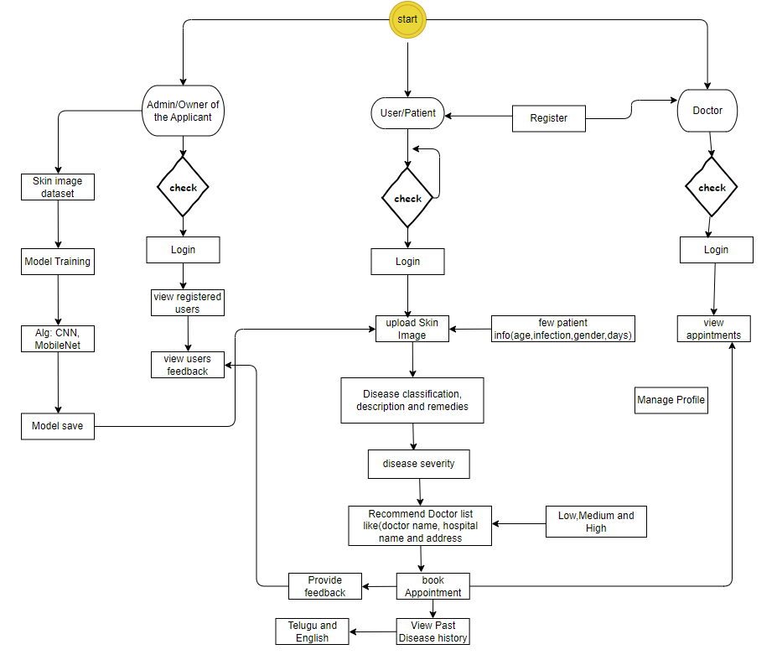
Block Diagram
Figure 1 Block diagram of the project

Slide 16
H/W AND S/W REQUIREMENTS
Hardware:
Operating system : Windows 7 or 7+
RAM : 8 GB
Hard disc or SSD : More than 500 GB
Processor : Intel 3rd generation or high or Ryzen with 8 GB Ram
Software:
Software’s : Python 3.6 or high version
IDE : PyCharm.
Framework : Flask

Slide 17
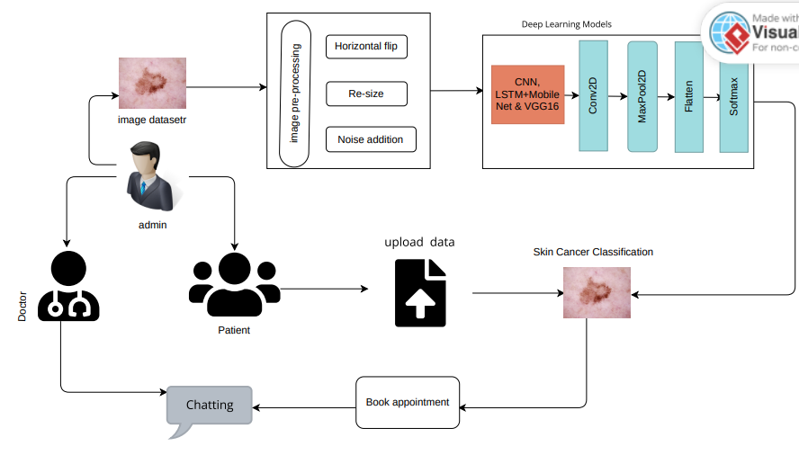
ARCHITECTURE

Slide 18
MODULES
System:
Collecting data:
It will collect the data what the user is providing
Pre-processing:
After collecting data we will pre-process the data by fixing the size of the images
Splitting:
The data will be split into train (70%-80%) and test (30%-20%) after pre-processing the data.
Training:
After splitting the data will be trained with different deep learning algorithms for the classification.
Classification:
Classifying the images which is taken as input and produce the output.

Slide 19
MODULES
Patient:
Register:
Patient need to register with the valid details of them.
Login:
Patient need to login with details what they have provided at registration.
Classification:
Patient will give the required information and will upload the data as per that we will classify the result and it will show thw classification result.
Booking appointment & Chatting:
Booking appointment as per the classification and if needed patient can chat with the doctor based on the problem.
Feedback:
Patient can provide the feedback on the doctor after completion their treatment.

Slide 20
MODULES
Doctor:
Register:
Doctor need to register with the valid details of them like name, mail, Hospital name, Experience of them etc.,
Login:
Patient need to login with details what they have provided at registration.
View Appointments:
Doctor can view the appointments related.
Accept Appointments:
As per their schedules they can adjust and accpept the appointments and after that it will reflected to patient.

Slide 21
MODULES
Admin:
Login:
Admin can login by using the details
Dash Board:
Admin can view the dash board with different graphs like confusion matrices of the algorithms.
View registrations:
Admin can view the registrations it may be the doctor it may be the patient.
View feedback:
Admin can view the feedback of the patient on the doctor.

Slide 22
ALGORITHM
Convolutional Neural Network (CNN)
For this dermatological diagnostic project, the Convolutional Neural Network (CNN) algorithm plays a central role due to its exceptional capability in image processing and analysis. CNN, a deep learning algorithm, is specifically designed to recognize and interpret visual information, making it ideal for analyzing complex dermatological images.
The CNN algorithm in this project operates through several layers, each designed to detect different features in the skin images. The initial layers identify basic features like edges and colors, while deeper layers recognize more complex patterns like textures and shapes associated with various skin conditions. This hierarchical feature extraction is crucial for accurately identifying a wide range of dermatological issues.

Slide 23
Mobile Net
MobileNet is a class of efficient models for mobile and edge devices, developed by Google. It stands out in the realm of Convolutional Neural Networks (CNNs) due to its streamlined architecture that balances the trade-off between performance and computational resource requirements. This balance is crucial for deploying high-accuracy models in resource-constrained environments, like smartphones and IoT devices.
The core innovation in MobileNet is the use of depthwise separable convolutions, a technique that significantly reduces the number of parameters and computational complexity compared to standard convolutions. In a traditional convolution layer, filters are applied that combine inputs from all channels of the previous layer. However, in a depthwise separable convolution, this process is split into two layers: a depthwise convolution followed by a pointwise convolution. The depthwise convolution applies a single filter per input channel, and the pointwise convolution then uses a 1x1 convolution to combine the output from the depthwise convolution across channels. This approach drastically reduces the computational cost and model size without a substantial decrease in performance.

Slide 24
MobileNet is characterized by its small size and lower latency, which makes it ideal for running on mobile and edge devices with limited computational power and memory. Despite its compact structure, MobileNet does not significantly compromise accuracy, making it suitable for a wide range of applications, including image classification, object detection, and facial recognition.
Additionally, MobileNet offers flexibility through hyperparameters like width multiplier and resolution multiplier, allowing developers to create models that best suit their specific needs for speed and accuracy. This scalability makes MobileNet a versatile choice for various applications in real-world scenarios, especially where the computational resources are a limiting factor.

Slide 25
UML DIAGRAMS
UML stands for Unified Modelling Language. UML is a standardized general-purpose modelling language in the field of object-oriented software engineering. The standard is managed, and was created by, the Object Management Group.
The goal is for UML to become a common language for creating models of object-oriented computer software. In its current form UML is comprised of two major components: a Meta-model and a notation. In the future, some form of method or process may also be added to; or associated with, UML.
The Unified Modelling Language is a standard language for specifying, Visualization, Constructing and documenting the artefacts of software system, as well as for business modelling and other non-software systems.
The UML represents a collection of best engineering practices that have proven successful in the modelling of large and complex systems.
The UML is a very important part of developing objects-oriented software and the software development process. The UML uses mostly graphical notations to express the design of software projects.

Slide 26
4.8.1 Use Case Diagram
A use case diagram in the Unified Modeling Language (UML) is a type of behavioral diagram defined by and created from a Use-case analysis.
Its purpose is to present a graphical overview of the functionality provided by a system in terms of actors, their goals (represented as use cases), and any dependencies between those use cases.
The main purpose of a use case diagram is to show what system functions are performed for which actor. Roles of the actors in the system can be depicted

Slide 27
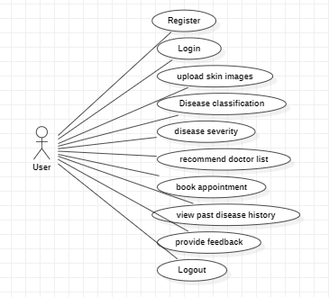
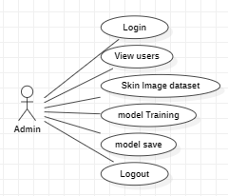
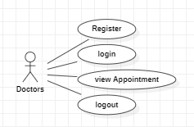
Figure 3 Use case diagram

Slide 28
4.8.2 Class Diagram
In software engineering, a class diagram in the Unified Modeling Language (UML) is a type of static structure diagram that describes the structure of a system by showing the system's classes, their attributes, operations (or methods), and the relationships among the classes. It explains which class contains information.

Slide 29
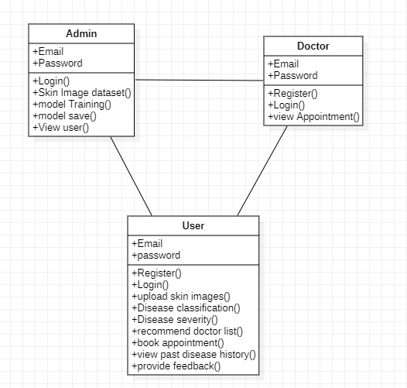
Figure 4 Class diagram

Slide 30
4.8.3 Sequence Diagram
A sequence diagram in Unified Modeling Language (UML) is a kind of interaction diagram that shows how processes operate with one another and in what order.
It is a construct of a Message Sequence Chart. Sequence diagrams are sometimes called event diagrams, event scenarios, and timing diagrams

Slide 31
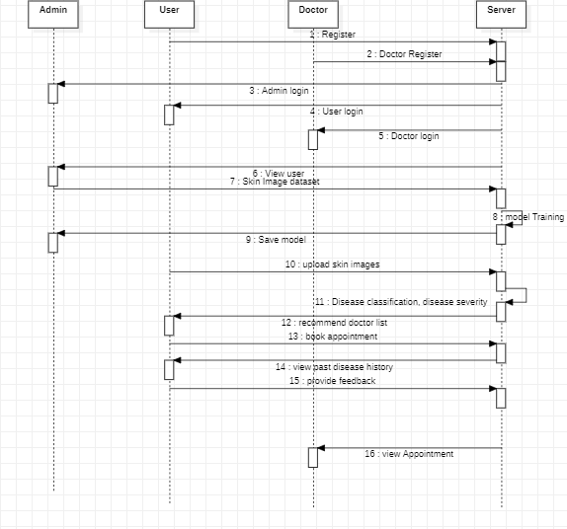
Figure 5 Sequence Diagram

Slide 32
4.8.4 Collaboration Diagram
In collaboration diagram the method call sequence is indicated by some numbering technique as shown below. The number indicates how the methods are called one after another. We have taken the same order management system to describe the collaboration diagram. The method calls are similar to that of a sequence diagram. But the difference is that the sequence diagram does not describe the object organization whereas the collaboration diagram shows the object organization.

Slide 33
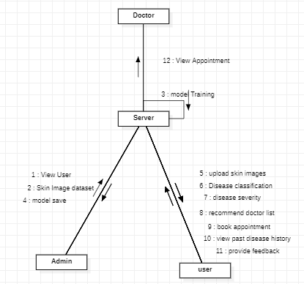

Slide 34
4.8.5 Development Diagram
Deployment diagram represents the deployment view of a system. It is related to the component diagram. Because the components are deployed using the deployment diagrams. A deployment diagram consists of nodes. Nodes are nothing but physical hardware’s used to deploy the application

Slide 35
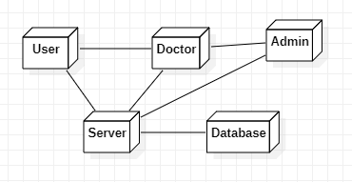
Figure 7 Deployment Diagram

Slide 36
4.8.6 Activity Diagram
Activity diagrams are graphical representations of workflows of stepwise activities and actions with support for choice, iteration and concurrency. In the Unified Modelling Language, activity diagrams can be used to describe the business and operational step-by-step workflows of components in a system. An activity diagram shows the overall flow of control

Slide 37
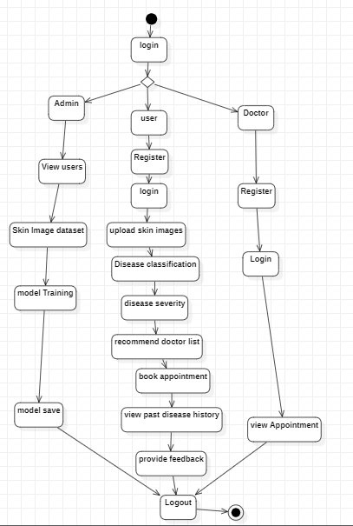
Figure 8 Activity Diagram

Slide 38
4.8.7 Component Diagram
A component diagram, also known as a UML component diagram, describes the organization and wiring of the physical components in a system. Component diagrams are often drawn to help model implementation details and double-check that every aspect of the system's required function is covered by planned development.

Slide 39
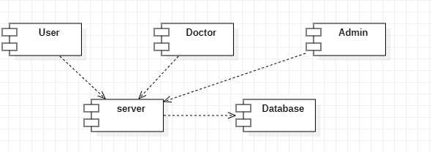

Slide 40
4.8.8 ER Diagram
An Entity–relationship model (ER model) describes the structure of a database with the help of a diagram, which is known as Entity Relationship Diagram (ER Diagram). An ER model is a design or blueprint of a database that can later be implemented as a database. The main components of E-R model are: entity set and relationship set.
An ER diagram shows the relationship among entity sets. An entity set is a group of similar entities and these entities can have attributes. In terms of DBMS, an entity is a table or attribute of a table in database, so by showing relationship among tables and their attributes, ER diagram shows the complete logical structure of a database. Let’s have a look at a simple ER diagram to understand this concept.

Slide 41
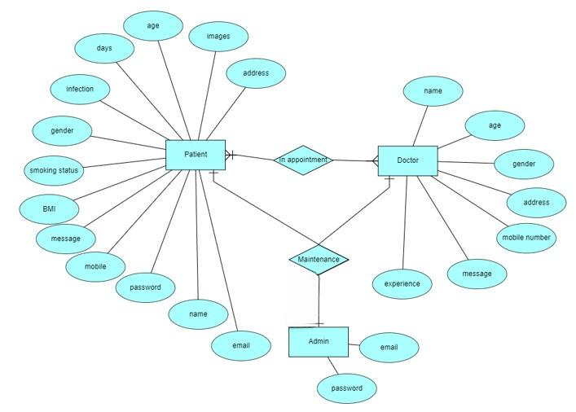

Slide 42
4.8.9 DFD Diagram
A Data Flow Diagram (DFD) is a traditional way to visualize the information flows within a system. A neat and clear DFD can depict a good amount of the system requirements graphically. It can be manual, automated, or a combination of both. It shows how information enters and leaves the system, what changes the information and where information is stored. The purpose of a DFD is to show the scope and boundaries of a system as a whole. It may be used as a communications tool between a systems analyst and any person who plays a part in the system that acts as the starting point for redesigning a system.

Slide 43
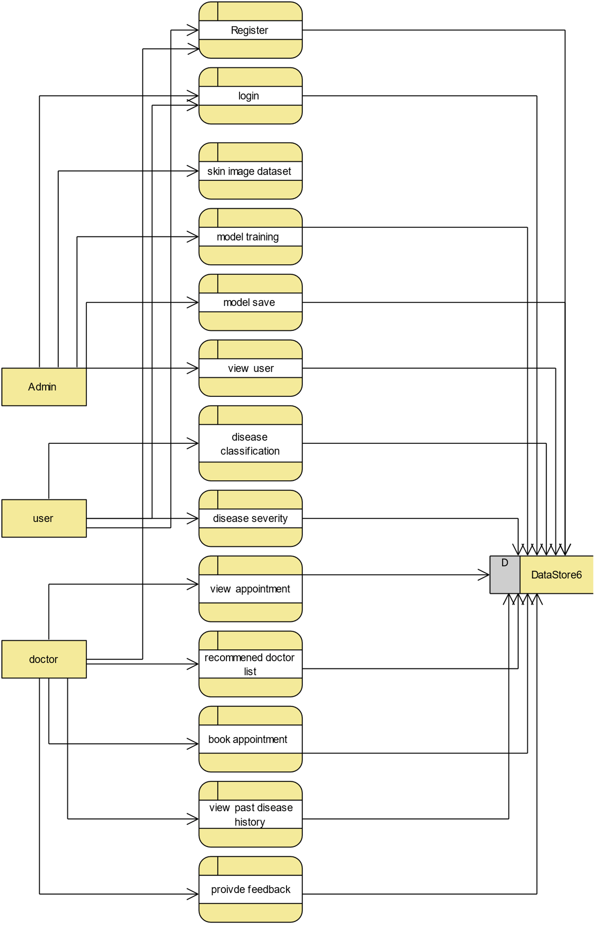

Slide 44
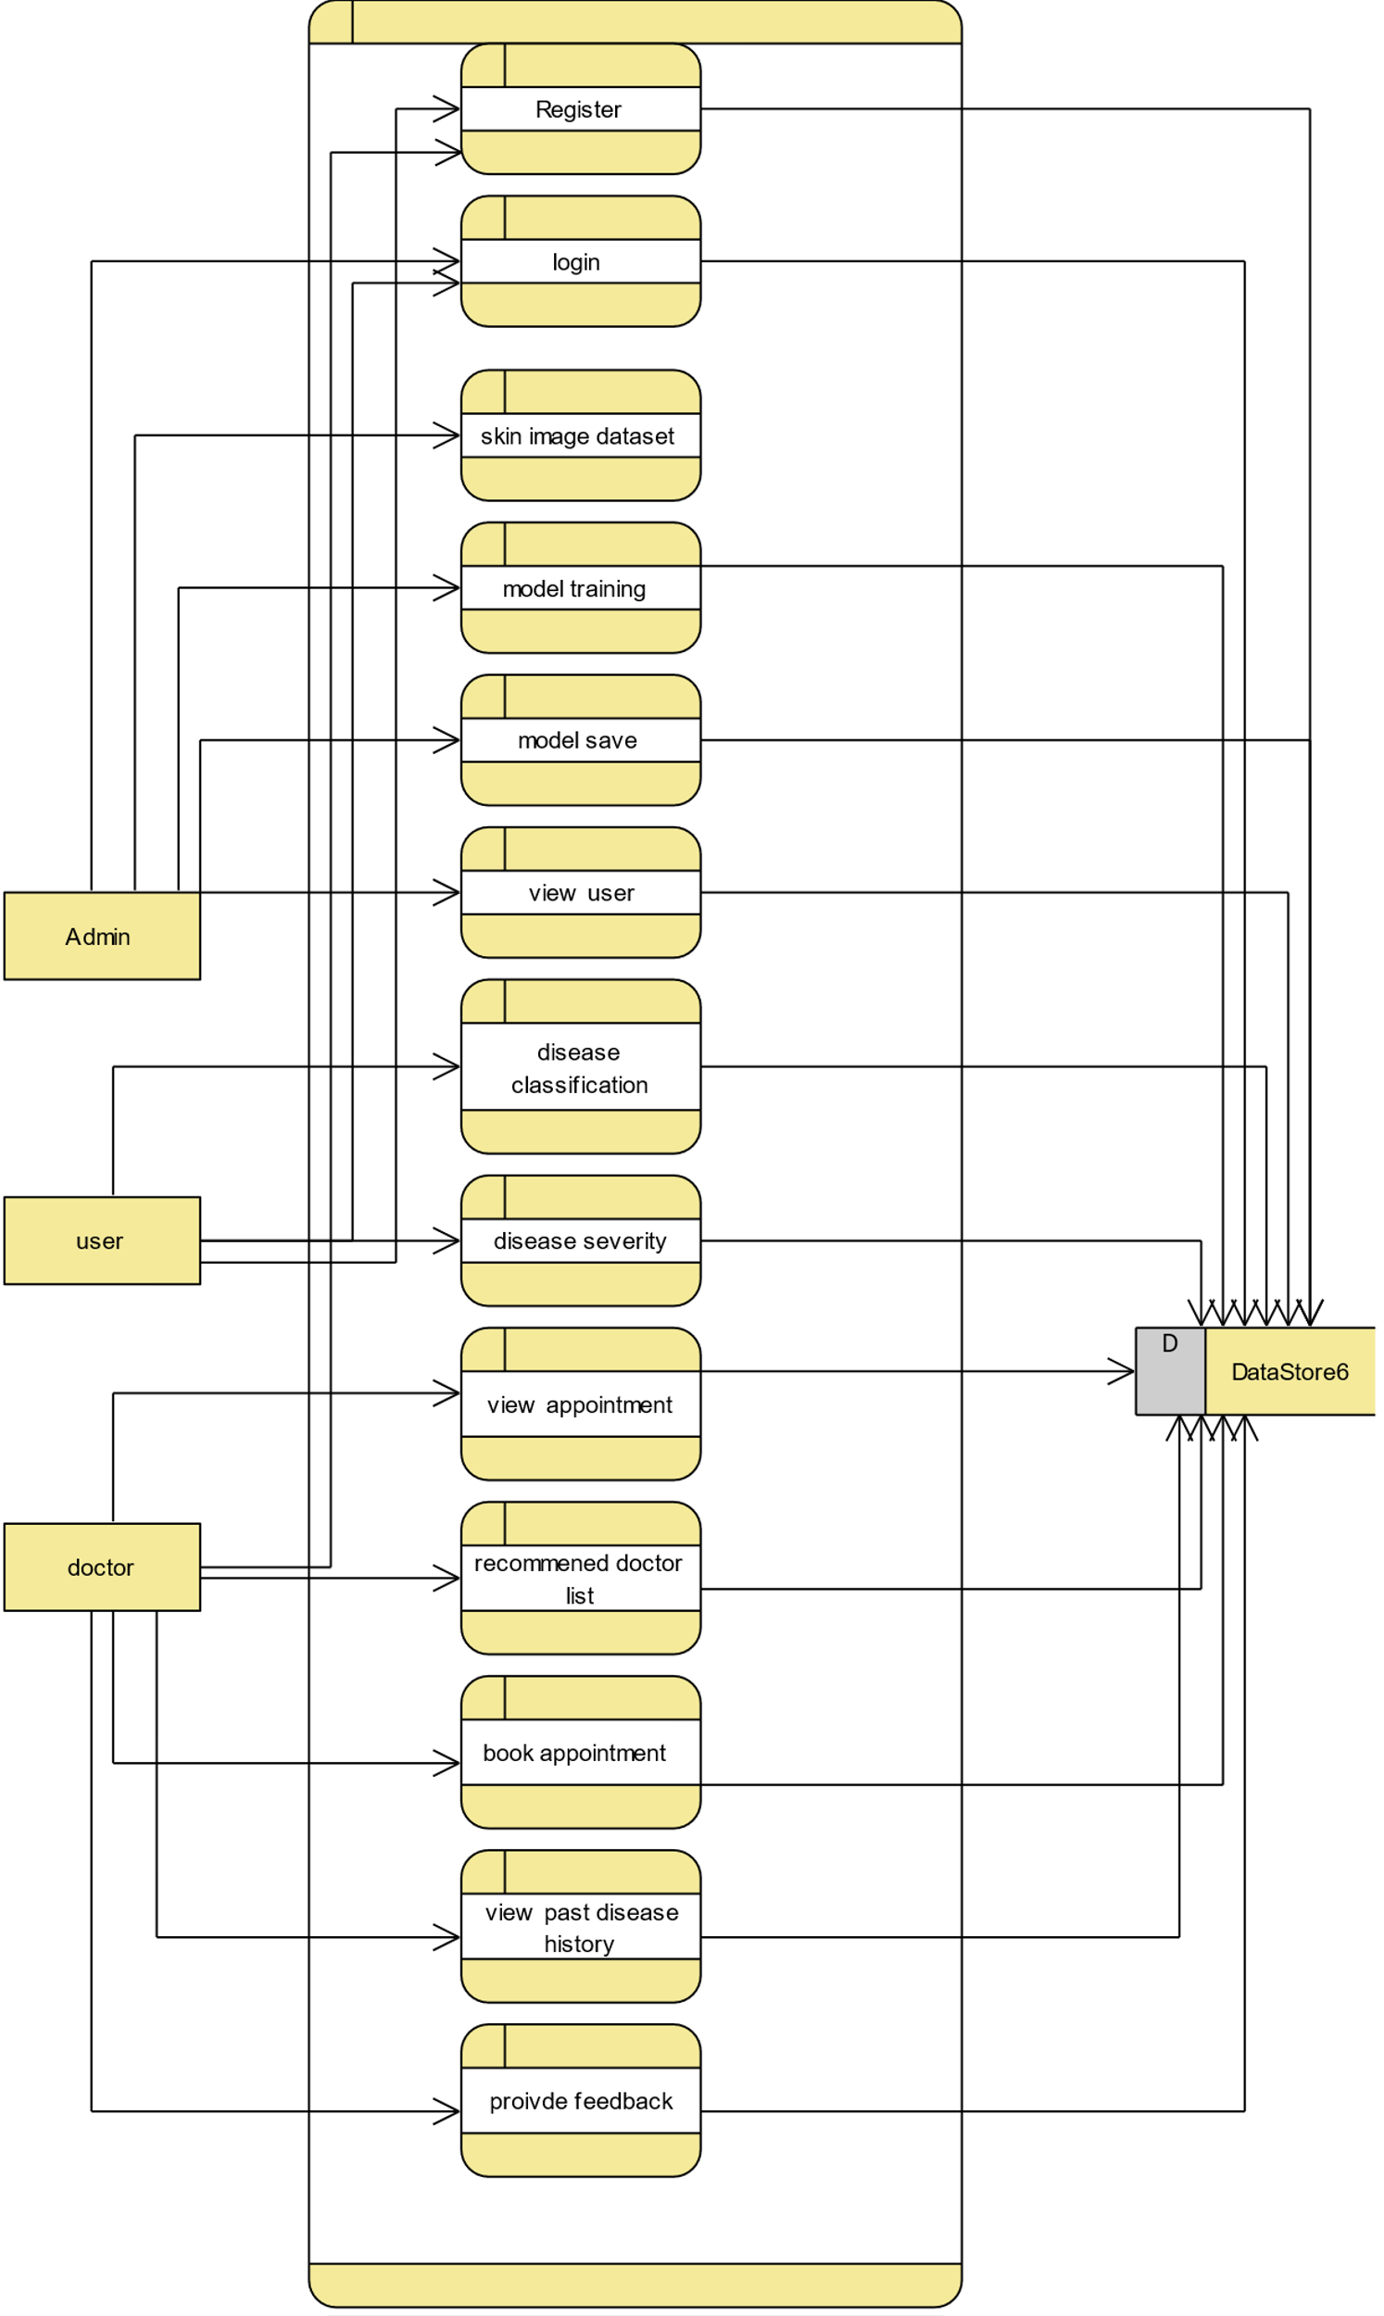

Slide 45
REFERENCES
1. Al-Masni, M. A., Al-Antari, M. A., Choi, M.-T., Han, S.-M., & Kim, T.-S. (2018). Skinlesion segmentation in dermoscopy images via deep full resolution convolutionalnetworks. Computer Methods and Programs in Biomedicine, 162, 221–231.
2. Alfed, N., Khelifi, F., Bouridane, A., & Seker, H. (2015). Pigment network-based skincancer detection. In 2015 37th annual international conference of the IEEE engineeringin medicine and biology society (EMBC) (pp. 7214–7217). IEEE.
3. Aljanabi, M., Özok, Y. E., Rahebi, J., & Abdullah, A. S. (2018). Skin lesion segmentationmethod for dermoscopy images using artificial bee colony algorithm. Symmetry,10(8), 347.
4. Biessmann, F., Salinas, D., Schelter, S., Schmidt, P., & Lange, D. (2018). ‘‘ Deep" learningfor missing value imputationin tables with non-numerical data. In Proceedings ofthe 27th ACM international conference on information and knowledge management (pp.2017–2025).
5.Canadian Cancer Society’s Advisory Committee on Cancer Statistics (2014). Canadiancancer statistics 2014 - special topic: Skin cancers. Retrieved from https://www.cancer.ca/statistics. (Accessed 30 December 2020).

